Slide 1
Talend Training
Class Room Course Content

Slide 2
Table of Contents
TALEND INTRODUCTION AND ARCHITECTURE
TALEND DATA INTEGRATION
2.1 Configuring Talend
2.2 DI Basics
2.3 Creating DB Connection
2.4 Importing tables from DB
2.5 Creating a sample Job
2.6 Context Parameters
2.7 Running Job locally
2.8 Important components
2.8.1 Transaction Components
2.8.2 Database Components
2.8.3 ELT
2.8.4 Parent & Child Relationship
TALEND BIG DATA DI
3.1 BIG DATA - What is it?
3.2 Metadata and Context
3.3 Setting up a Database System
3.4 Variables
3.5 Hadoop Components
CONFIGURING AND RUNNING THE JOBS ON REMOTE SERVER FROM STUDIO
TALEND ADMINISTRATION CENTER

Slide 3
Talend Introduction and Architecture

Slide 4
Talend - Introduction
Talend is the leading open source integration software provider to data-driven enterprises.
It’s modern data platform and open source approach simplifies
the development process
reduces the learning curve
decreases total cost of ownership
to connect more data
Talend connects at big data scale, 5x faster and at 1/5th the cost.

Slide 5
Scope
Talend addresses all of an organization’s data integration needs:
Synchronization or replication of databases
Right-time or batch exchanges of data
ETL (Extract Transform Load) for BI or analytics
Data migration
Complex data transformation and loading
Basic data quality
Big Data.

Slide 6
History
Talend was founded in 2005 by Bertrand Diard and Fabrice Bonan. Headquartered in Redwood City, California.
The company's first product. Talend Open Studio for Data Integration was launched in October 2006.
Currently Talend has more than 4000 paying customers including eBay, Sony Online Entertainment ,Disney etc.
Current version available is 6.2.0.
More than 900+ built-in connectors that allow you to easily link a wide array of sources and targets.

Slide 7






Products
Big Data Integration Application Integration
Data Integration Data Preparation
Cloud Integration Master Data Management

Slide 8
Products (Contd..)
Big data integration - Realize the speed and scale of Big Data without coding
Data integration - Respond to business needs for integrated data
Cloud integration - Connect all your data in the cloud and on premises
Application integration - Deliver agile real-time integration of applications
Data preparation - Fast and easy self-service data prep for everyone
Master data management - Empower business with a single view of the truth

Slide 9
Talend - Architecture
The operating principles of the Talend products could be summarized as briefly as the following topics:
building technical or business-related processes,
administrating users, projects, access rights and processes and their dependencies,
deploying and executing technical processes,
monitoring the execution of technical processes.
Each of the above topics can be isolated in different functional blocks and the different types of blocks and their interoperability can be described as in the following architecture diagram

Slide 10
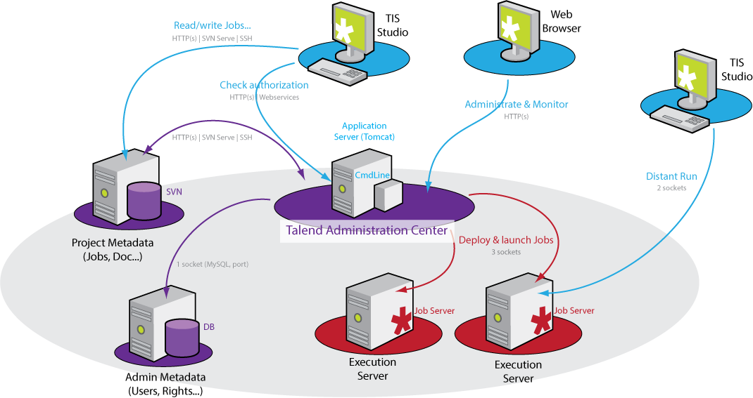
Talend – Architecture (Contd..)

Slide 11
Talend Data Integration

Slide 12
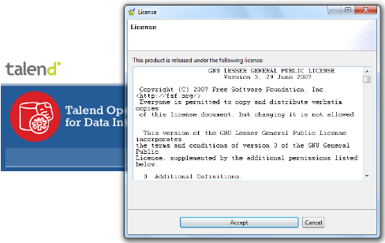
Configuring Talend
Downloading Talend
Download the Talend Open Studio zip file from the Talend website (http://www.talend.com/). Talend may be installed on Windows, OSX, Unix and Linux.
Unzip the downloaded file and in the folder click the executable file corresponding to your operating system.
The below startup window appears.

Slide 13
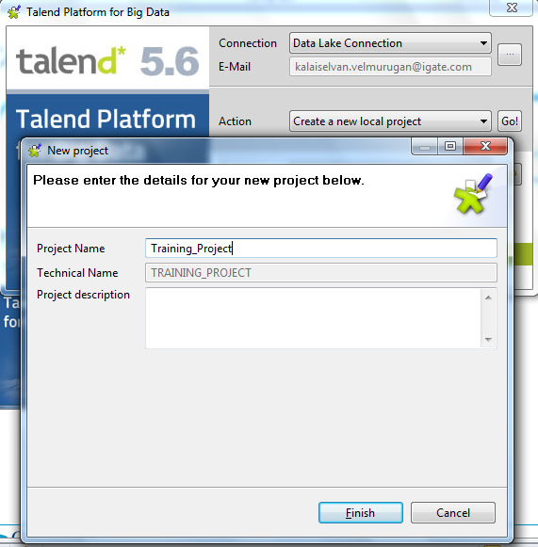
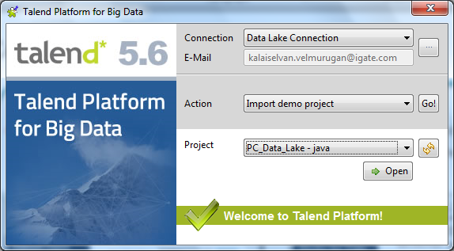
Configuring Talend (Contd..)
Click the Import button to import the selected demo project, or type in a project name in the Create A New Project field and click the Create button to create a new project, or click the Advanced... button to go to the Studio login window.

Slide 14
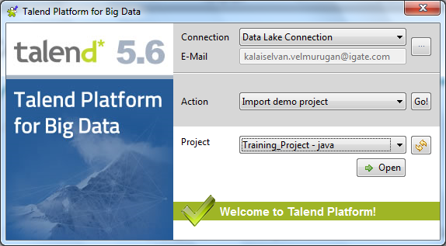
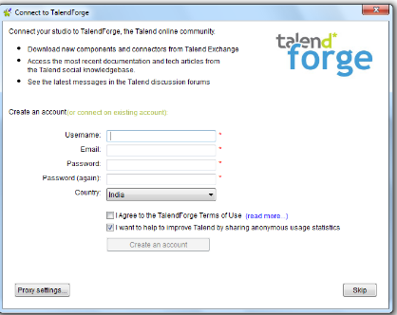
Configuring Talend (Contd..)
5. Select the appropriate option and click open.
6. The Connect to Talend Forge page appears. Inviting you to connect to the Talend Community where you can check, download, install external components and upload your own components.

Slide 15
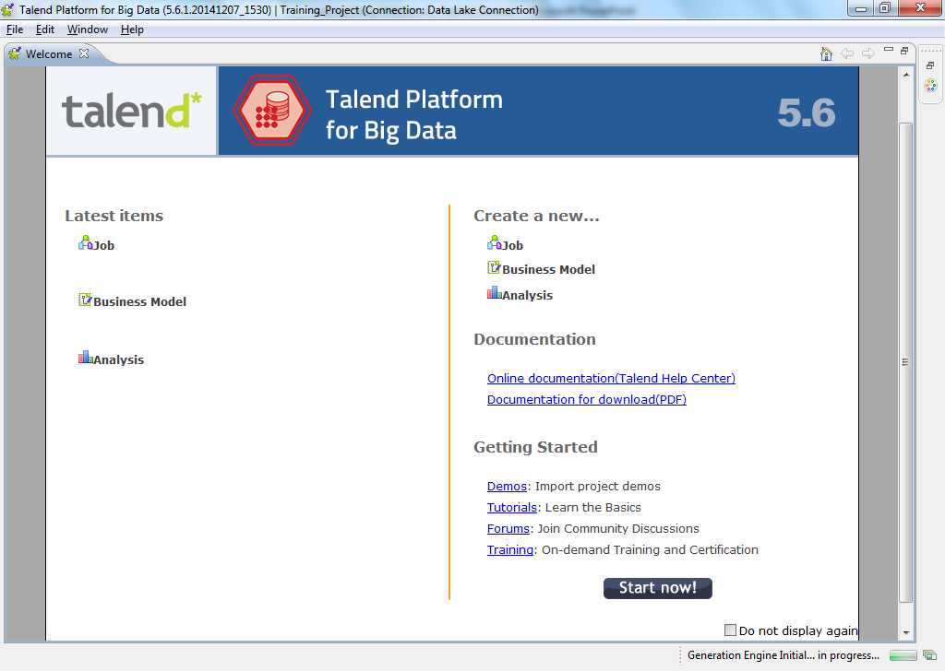
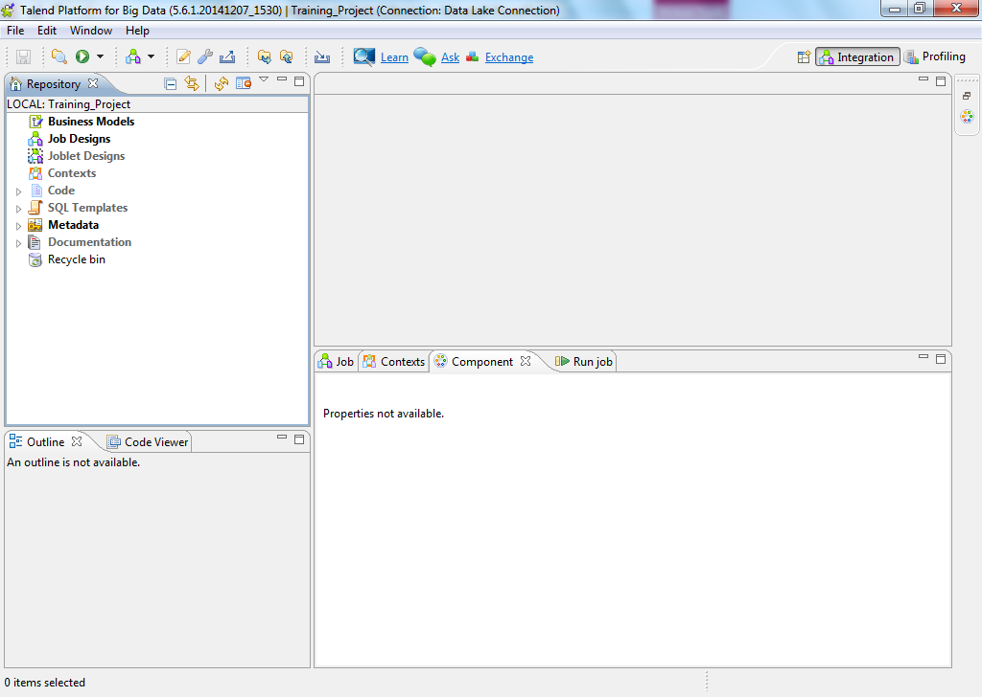
Configuring Talend (Contd..)
7. Click on Create Account or Skip button
to move on welcome window.
8. Click Start now to open Talend
Open Studio for Data Integration
main window.

Slide 16
Data Integration Basics
The fastest and the most cost effective way to connect data.
Robust data integration in an open and scalable architecture
Provides unified tools to integrate, cleanse, mask and profile all of the data
Over 900+ prebuilt components to connect various data sources
Offers collaboration and management tools
Synchronize metadata
Deliver self-service data preparation to everyone

Slide 17
Creating DB Connection
To create a new database connection within the repository, right-click Repository->Metadata->DB Connections and select the option Create connection. This will display the Database Connection dialog.
Enter a Name, Purpose and Description for your database connection.
Use a Name that suggests its purpose, for example, Development Accounts indicating that this connection is for the development instance of your Accounts database.
Always establish these connections to a development or test database and never to production
Should be consistent in the databases that you connect to and the naming conventions you use.

Slide 18
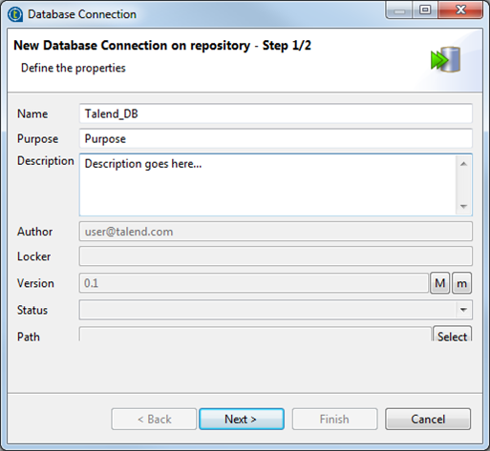
Creating DB Connection (Contd..)
3. When you've completed step 1 of this dialog,
press Next, as shown in the screenshot below.

Slide 19
Database Connection Parameters
Step 2 of the Database Connection dialog allows you to enter the connection parameters of the database that you want to connect to.
Select the DB Type that you want to connect to.
For some database vendors, there may be multiple types that you may select, for example, Oracle connections are supported using OCI, RAC, SID and Service Name.
Once you have selected a DB type, the remainder of the dialog will be preconfigured for the database vendor and connection type that you selected. As shown below, for MySQL, we have some basic setings that we need to make for a connection to a MySQL 5database.

Slide 20
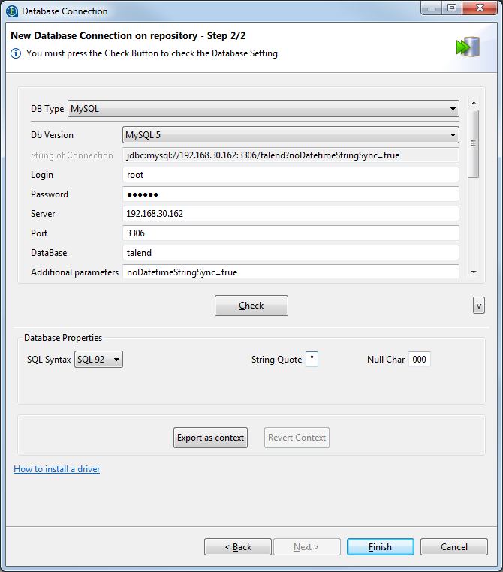
Database Connection Parameters (Contd..)
3. When you have completed this page of the dialog,
you can Check your connection and then hit Finish.

Slide 21
Importing tables from DB
Before importing database connection metadata from a CSV file, make sure that your CSV file format is valid. The file columns should be filled as follows:
Name; Purpose; Description; Version; Status; Db Type; Connection String; Login; Password; Server; Port; Database; DB Schema; Data source; File; DB Root; Table Name; Original Table Name; Label; Original Label; Comment; Default; Key; Length; Null able; Pattern; Precision; Talend Type; DB Type.
It is recommended to use either Talend Type or DB Type, not both.
Table Name is the name displayed in Talend Studio, original Table Name is the original table name in the database. (You can choose to fill only the original Table Name).
Label is the column name used in Talend Studio; original Label is the column name in the table. (You can choose to fill only the original Label).

Slide 22
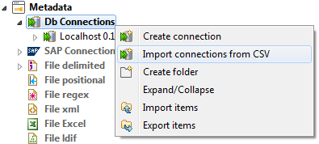
Importing tables from DB (Contd..)
To import database connection metadata from a defined CSV file, do the following:
In the Repository tree view, expand the Metadata node and right-click Db connections.
In the contextual menu, select Import connections from CSV.

Slide 23
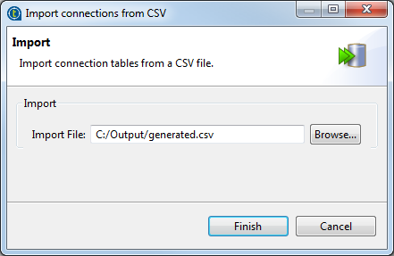
Importing tables from DB (Contd..)
Click Browse... and go to the CSV file that holds the metadata of the database connection.

Slide 24
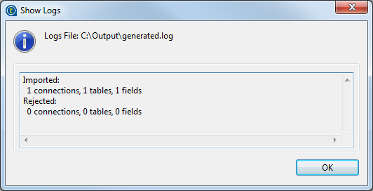
Importing tables from DB (Contd..)
Click Finish to close the dialog box.
The [Show Logs] dialog bow displays to list imported and rejected metadata, if any.

Slide 25
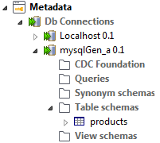
Importing tables from DB (Contd..)
Click OK to close the dialog box.
The imported metadata displays under the DB connections node in the Repository tree view.

Slide 26
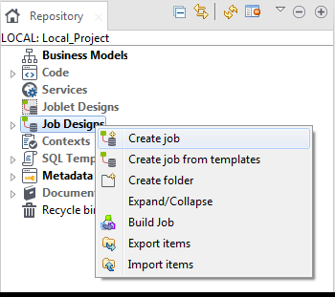
Creating a Sample Job
Talend Studio enables you to create a Job by dropping different technical components from the Palette onto the design workspace and then connecting these components together.
In the Repository tree view of the Integration perspective, right-click the Job Designs node and select Create job from the contextual menu

Slide 27
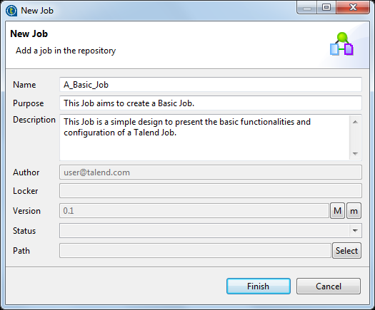
Creating a Sample Job (Contd..)
The [New Job] wizard opens to help you define the main properties of the new Job.

Slide 28
Creating a Sample Job (Contd..)
Fill the Job properties as shown in the previous screenshot. The fields correspond to the following properties:
Field | Description
Name | the name of the new Job. Note that a message comes up if you enter prohibited characters.
Purpose | Job purpose or any useful information regarding the Job use.
Description | Job description containing any information that helps you describe what the Job does and how it does it.
Version | a read-only field. You can manually increment the version using the M and m buttons. For more information, see the Getting Started Guide.
Locker | a read-only field that shows by default the login of the user who owns the lock on the current Job. This field is empty when you are creating a Job and has data only when you are editing the properties of an existing Job.
Author | a read-only field that shows by default the current user login.
Status | a list to select from the status of the Job you are creating.
Path | a list to select from the folder in which the Job will be created.

Slide 29
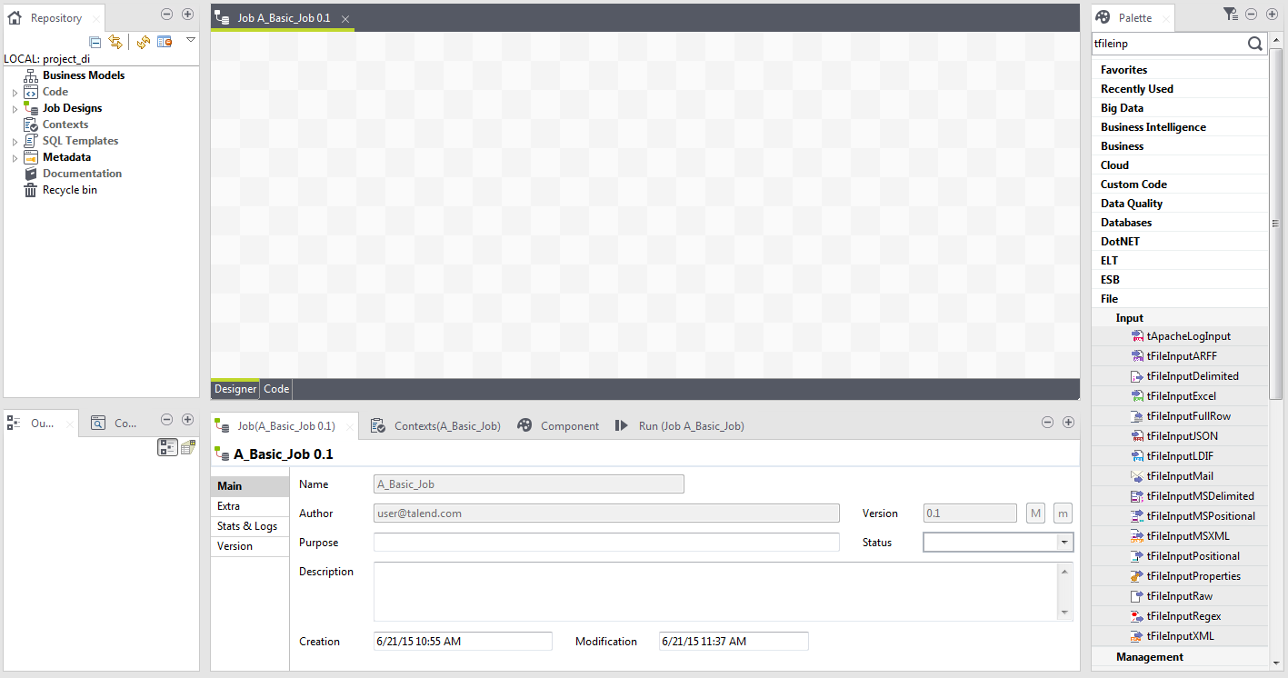
Creating a Sample Job (Contd..)
An empty design workspace opens up showing the name of the Job as a tab label.
The Job you created is now listed under the Job Designs node in the Repository tree view.
You can open one or more of the created Jobs by simply double-clicking the Job label in the Repository tree view.

Slide 30
Context Parameters
You can define context variables for a particular Job in two ways:
Using the Contexts view of the Job.
Using the F5 key from the Component view of a component.
How to define context variables in the Contexts view?
The Contexts view is positioned among the configuration tabs below design workspace.
If you cannot find the Contexts view on the tab system of Talend Studio, go to Window > Show view > Talend, and select Contexts.
The Contexts tab view shows all of the variables that have been defined for each component in the current Job and context variables imported into the current Job.

Slide 31
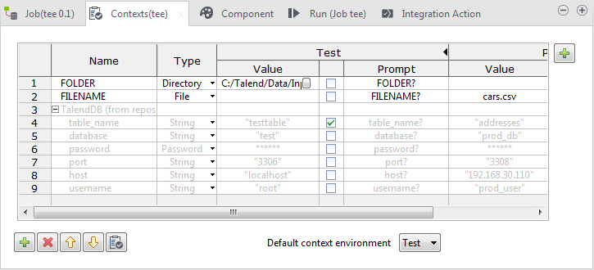
Context Parameters (Contd..)

Slide 32
Context Parameters (Contd..)
From this view, you can manage your built-in variables:
Create and manage built-in contexts.
Create, edit and delete built-in variables.
Reorganize the context variables.
Add built-in context variables to the Repository.
Import variables from a Repository context source for use in the current Job.
Edit Repository-stored context variables and update the changes to the Repository.
Remove imported Repository variables from the current Job.

Slide 33
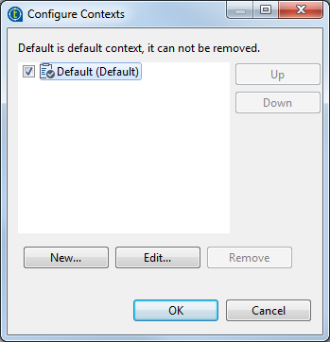
Defining Contexts
Open the Job in the design workspace.
Select the Contexts tab view and click the [+] button at the upper right corner of the view.
The [Configure Contexts] dialog box pops up.
A context named Default has been created
and set as the default one by the system.

Slide 34
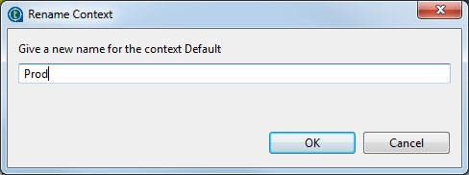
Defining Contexts (Contd..)
Select the context Default, click the Edit... button and enter Prod in the [Rename Context] dialog box that opens to rename the context Default to Prod.
Then click OK to close the dialog box.

Slide 35
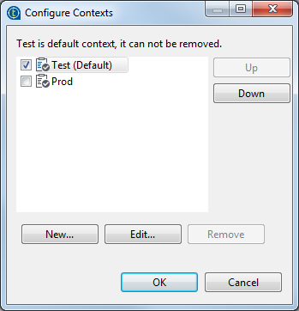
Defining Contexts (Contd..)
Click the New... button and enter Test in the [New Context] dialog box. Then click OK to close the dialog box.
Select the check box preceding the context you want to set as the default context. You can also set the default context by selecting the context name from the Default context environment list in the Contexts tab view.
If needed, move a context up or down
by selecting it and clicking the Up or
Down button. In this example, set Test
as the default context and move it up.

Slide 36
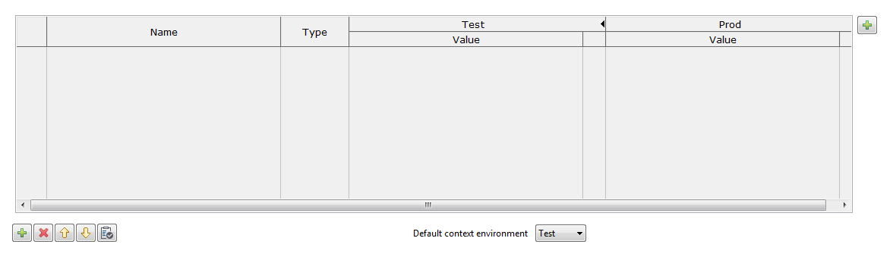
Defining Contexts (Contd..)
Click OK to validate your context definition and close the [Configure Contexts] dialog box.
The newly created contexts are shown in the context variables table of the Contexts tab view.

Slide 37
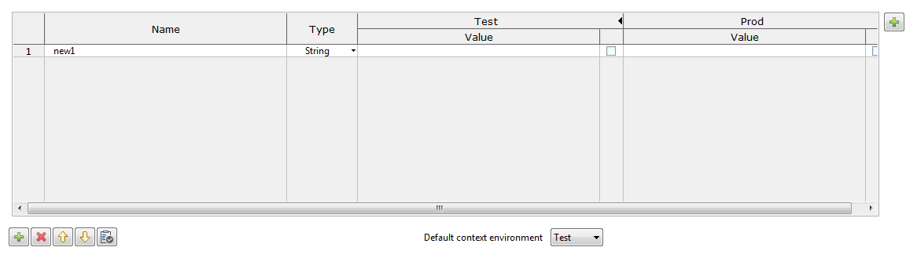
Defining Variables
Click the [+] button at the bottom of the Contexts tab view to add a parameter line in the table.

Slide 38
Defining Variables (Contd..)
Click in the Name field and enter the name of the variable you are creating, host in this example.
From the Type list, select the type of the variable corresponding to the component field where it will used, String for the variable host in this example.
For different variable types, the Value field appear slightly different when you click in it and functions differently:

Slide 39
Defining Variables (Contd..)
Type | Value field | Default value
String (default type) | Editable text field | null
Password | Editable text field; text entered appears encrypted.
List of Value | Editable text field, with a button to open the [Configure Values] dialog box for list creation and configuration. | (Empty)
File | Editable text field, with a button to open the [Open] dialog box for file selection.
Directory | Editable text field, with a button to open the [Browse for Folder] dialog box for folder selection.
Date | Editable text field, with a button to open the [Select Date & Time] dialog box.
Character, Double, Integer, Long, Short,Object, BigDecimal | Editable text field
Boolean | Drop-down list box with two options: true and false

Slide 40
Defining Variables (Contd..)
Click in Value field and enter the variable value under each context.
If needed, select the check box next the variable of interest and enter the prompt message in the corresponding Prompt field. This allows you to see a prompt for the variable value and to edit it at the execution time.
You can show/hide a Prompt column of the table by clicking the black right/left pointing triangle next to the relevant context name.

Slide 41
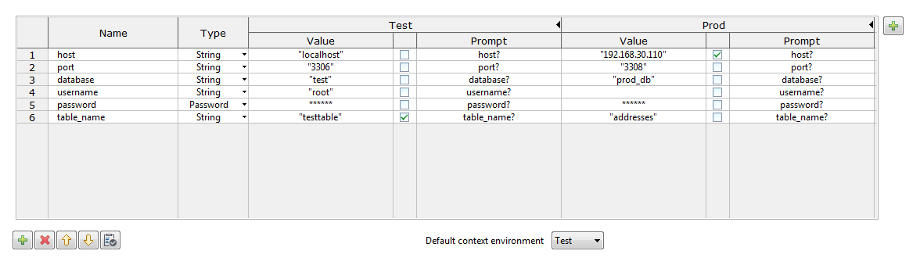
Defining Variables (Contd..)
Repeat the steps above to define all the variables in this example.
port, type String,
database, type String,
username, type String,
password, type Password,
table name, type String.
All the variables created and their values under different contexts are displayed in the table and are ready for use in your Job. You can further edit the variables in this view if needed.

Slide 42
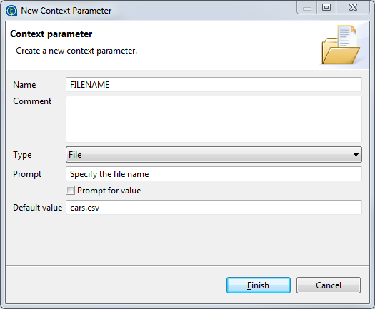
How to define variables from the Component view?
1. The quickest way to create a single context variable is to use the F5 key from
the Component view
2. On the relevant Component view,
place your cursor in the field
you want to parameterize
3. Press F5 to display the
[New Context Parameter] dialog
box

Slide 43
How to define variables from the Component view? (Contd..)
Give a Name to this new variable, fill in the Comment field if needed, and choose the Type.
Enter a Prompt to be displayed to confirm the use of this variable in the current Job execution (generally used for test purpose only), select the Prompt for value check box to display the prompt message and an editable value field at the execution time.
If you filled in a value already in the corresponding properties field, this value is displayed in the Default value field. Else, type in the default value you want to use for one context.
Click Finish to validate.
Go to the Contexts view tab. Notice that the context variables tab lists the newly created variables.
The newly created variables are listed in the Contexts view.

Slide 44
How to define variables from the Component view? (Contd..)
The variable created this way is automatically stored in all existing contexts, but you can subsequently change the value independently in each context. For more information on how to create or edit a context, see Defining contexts.

Slide 45
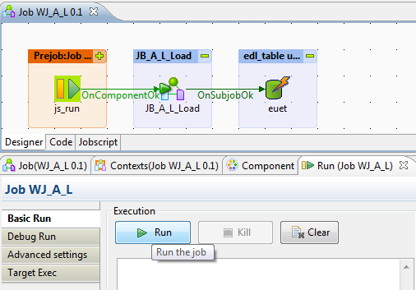
Running the Job Locally
How a Talend Spark Job works:
Using the Spark-specific components, a Talend Spark Job makes use of the Spark framework to process RDDs (Resilient Distributed Datasets) on top of a given Spark cluster.
Depending on which framework you select for the Spark Job you are creating, this Talend Spark Job implements the Spark Streaming framework or the Spark framework when generating its code.
A Talend Spark Job can be run locally. The Studio builds the Spark environment in itself at runtime to run the Job locally within the Studio. With this mode, each processor of the local machine is used as a Spark worker to perform the computations. This mode requires minimum parameters to be set in this configuration view.
Note: this local machine is the machine in which the Job is actually run.

Slide 46
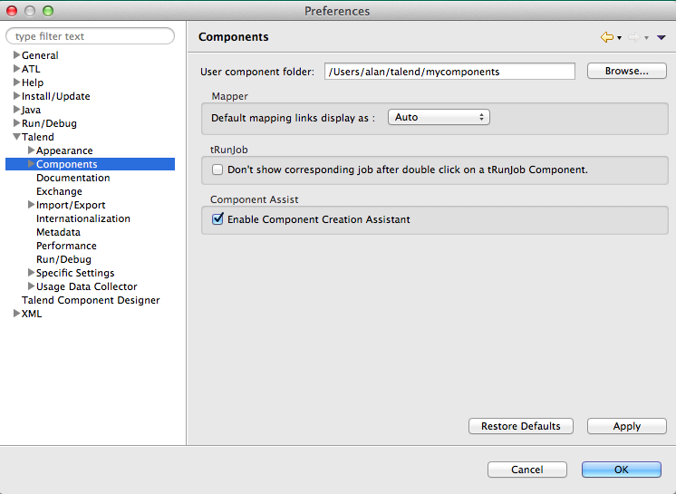
Important Components of Talend DI
A component is a preconfigured connector used to perform a specific data integration operation
A component can minimize the amount of hand-coding required to work on data from multiple, heterogeneous sources.

Slide 47
Components of Talend DI
Components of Talend DI
Big Data components | Databases - other components | Misc. group components
Business components | DotNET components | Orchestration components
Business Intelligence components | ELT components | Processing components
Cloud components | ESB components | System components
Custom Code components | File components | Talend MDM components
Data Quality components | Internet components | Technical components
Databases - traditional components | Logs & Errors components | XML components
Databases - appliance/ data warehouse components

Slide 48
Transformation / Processing Components
tSortRow: This transformation component is used for sorting the input based on one or several columns by sort type.
In the below snapshot I am passing an excel as an input and applying the sorting transformation to sort the data in the excel, and the sorted output is transferred to other excel.

Slide 49
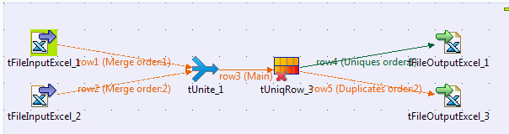
Transformation Components (Contd..)
tUnite & tUniqRow: The tUnite transformation is used for merging the data from various sources, based on a common schema. The tUniqRow transformation is used to remove duplicate records.
In the below snapshot I have merged the records from two different excels and have applied the tUniqrow transformation on the output and have split the output in two excels one containing the duplicate rows and other one containing the unique rows.

Slide 50
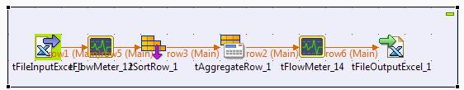
Transformation Components (Contd..)
tAggregateRow & tFlowMeter: The transformation tAggregateRow is used to perform aggregate operations such as Count, Min, Max, Avg, Sum Etc.
The transformation tFlowMeter is used to count the number of rows processed in the defined flow.
In the below example passing an Excel as a input having few employee related records, first it will sort the records using tSortRow transformation based on the Emp_ID, further aggregate operations such as count, min and max are performed on the sorted input and output is finally stored in the excel.
Here the tFlowMeter between the input file and tSortRow will give the number of records passed to the tSortRow transformation.

Slide 51
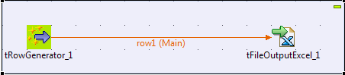
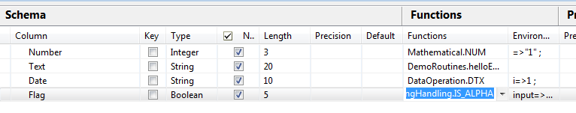
Transformation Components (Contd..)
tFilterRow: In this transformation tRowGenerator generates as many rows and fields as are required using random values taken from a list.
There is an option to define functions to generate the records.

Slide 52
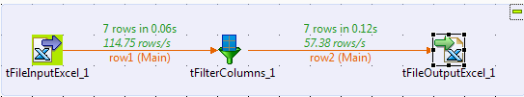
Transformation Components (Contd..)
tFilterColumn: This transformation is used to remove any unwanted column from you input.
For example in the below snapshot; In the input excel file I have 4 columns, after using the tFilterColumn I have removed the one of the columns and in the output excel there are only 3 columns

Slide 53
Transformation Components (Contd..)
tRowGenerator: In this transformation tRowGenerator generates as many rows and fields as are required using random values taken from a list.
There is an option to define functions to generate the records.

Slide 54
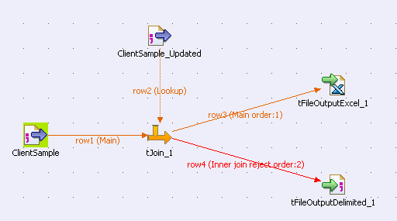
Transformation Components (Contd..)
tJoin: It joins two tables by doing an exact match on several columns.
It compares columns from the main flow with reference columns from the lookup flow and outputs the main flow data and/or the rejected data.
This component helps you ensure the data quality of any source data against a reference data source.

Slide 55
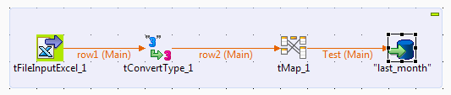
Transformation Components (Contd..)
tConvertType: In this transformation tConvertType component allows specific conversions at run time from one data type to another data type without writing any parsing statement.
In the below mentioned example; the Input is flat file so all the columns data type is string but in the final target table all the columns are not string , there are integer datatype column in this parsing is required, so we can use tConvertType which will handle all the parsing requirements.

Slide 56
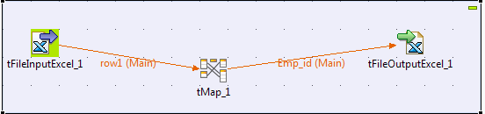
Transformation Components (Contd..)
tMap: In this transformation tMap transforms and routes data from single or multiple sources to single or multiple destinations.
In the below mentioned example I have mapped the Emp_id column of input excel with the output excel, plus I have also added function in tMap and added one more column in the output excel, which shows the insert timestamp of the record. tMap component is also mainly used to perform all your lookup tasks as well, you can also define variable and expressions in this component.

Slide 57
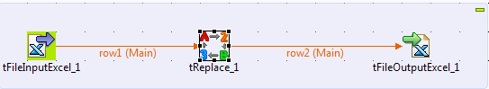
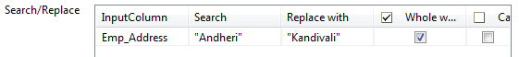
Transformation Components (Contd..)
tReplace: In this transformation tReplace we can search and replace records in the given input.
In the below mentioned snapshot I am passing one excel as input . By using this transformation we replace a specific records with any other value. Like here I am searching for the record ‘Andheri’ in the column Emp_Address and if it’s found then it is replaced with the value ‘Kandivali’

Slide 58
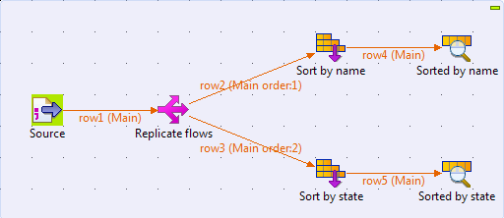
Transformation Components (Contd..)
tReplicate: Duplicate the incoming schema into two identical output flows. Allows you to perform different operations on the same schema. A schema is a row description.
It defines the number of fields (columns) to be processed and passed on to the next component. The schema is either Built-In or stored remotely in the Repository.

Slide 59
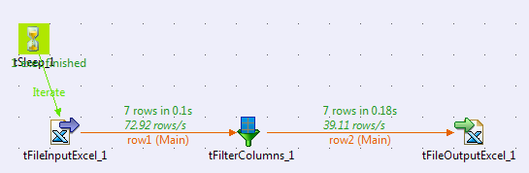
Transformation Components (Contd..)
tsleep: By using this transformation we need to implement time off in job execution. The amount of time you want to off in the job execution is mentioned in terms of seconds.

Slide 60
Database Component
These include connectors for the most popular and traditional databases.
These connectors cover various needs, including:
opening connections,
reading and writing tables,
committing transactions as a whole,
performing rollback for error handling.
Over 40 RDBMS are supported. Other types of database connectors, such as connectors for Appliance/DW databases and database management.
There are about 346 components under the Database component category.

Slide 61
Database Component (Contd..)
Databases - Traditional components
tAccessBulkExec | tDB2Commit | tInformixSP | tMSSqlTableList | tOleDbRow | tPostgresqlOutput
tAccessClose | tDB2Connection | tMemSQLClose - Databases | tMysqlBulkExec | tOracleBulkExec | tPostgresqlOutputBulk
tAccessCommit | tDB2Input | tMemSQLConnection - Databases | tMysqlClose | tOracleClose | tPostgresqlOutputBulkExec
tAccessConnection | tDB2Output | tMemSQLInput - Databases | tMysqlColumnList | tOracleCommit | tPostgresqlRollback
tAccessInput | tDB2Rollback | tMemSQLOutput - Databases | tMysqlCommit | tOracleConnection | tPostgresqlRow
tAccessOutput | tDB2Row | tMemSQLRow - Databases | tMysqlConnection | tOracleInput | tPostgresqlSCD - Databases
tAccessOutputBulk | tDB2SCD - Databases | tMSSqlBulkExec | tMysqlInput | tOracleOutput | tPostgresqlSCDELT - Databases
tAccessOutputBulkExec | tDB2SCDELT - Databases | tMSSqlColumnList | tMysqlLastInsertId | tOracleOutputBulk | tSybaseBulkExec
tAccessRollback | tDB2SP | tMSSqlClose | tMysqlLookupInput | tOracleOutputBulkExec | tSybaseClose
tAccessRow | tInformixBulkExec | tMSSqlCommit | tMysqlOutput | tOracleRollback | tSybaseCommit
tAS400Close | tInformixClose | tMSSqlConnection | tMysqlOutputBulk | tOracleRow | tSybaseConnection
tAS400Commit | tInformixCommit | tMSSqlInput | tMysqlOutputBulkExec | tOracleSCD - Databases | tSybaseInput
tAS400Connection | tInformixConnection | tMSSqlLastInsertId | tMysqlRollback | tOracleSCDELT - Databases | tSybaseIQBulkExec

Slide 62
Database Component (Contd..)
Databases - Appliance/Datawarehouse components
tGreenplumBulkExec | tIngresBulkExec | tNetezzaClose | tParAccelConnection | tRedshiftInput | tTeradataFastLoadUtility
tGreenplumClose | tIngresClose | tNetezzaCommit | tParAccelInput | tRedshiftOutput | tTeradataInput
tGreenplumCommit | tIngresCommit | tNetezzaConnection | tParAccelOutput | tRedshiftOutputBulk | tTeradataMultiLoad
tGreenplumConnection | tIngresConnection | tNetezzaInput | tParAccelOutputBulk | tRedshiftOutputBulkExec | tTeradataOutput
tGreenplumGPLoad | tIngresInput | tNetezzaNzLoad | tParAccelOutputBulkExec | tRedshiftRollback | tTeradataRollback
tGreenplumInput | tIngresOutput | tNetezzaOutput | tParAccelRollback | tRedshiftRow | tTeradataRow
tGreenplumOutput | tIngresOutputBulk | tNetezzaRollback | tParAccelRow | tRedshiftUnload | tTeradataSCD - Databases
tGreenplumOutputBulk | tIngresOutputBulkExec | tNetezzaRow | tParAccelSCD - Databases | tTeradataClose | tTeradataSCDELT - Databases
tGreenplumOutputBulkExec | tIngresRollback | tNetezzaSCD - Databases | tRedshiftBulkExec | tTeradataCommit | tTeradataTPTExec
tGreenplumRollback | tIngresRow | tParAccelBulkExec | tRedshiftClose | tTeradataConnection | tTeradataTPTUtility
tGreenplumRow | tIngresSCD - Databases | tParAccelClose | tRedshiftCommit | tTeradataFastExport | tTeradataTPump
tGreenplumSCD - Databases | tNetezzaBulkExec | tParAccelCommit | tRedshiftConnection | tTeradataFastLoad | tVectorWiseCommit

Slide 63
Database Component (Contd..)
Databases - Other components
tCassandraBulkExec - Databases | tCouchDBClose - Databases | tEXAInput | tFirebirdCommit | tHiveCreateTable - Databases | tInterbaseRollback
tCassandraClose - Databases | tCouchDBConnection - Databases | tEXAOutput | tFirebirdConnection | tHiveInput - Databases | tInterbaseRow
tCassandraConnection - Databases | tCouchDBInput - Databases | tEXARollback | tFirebirdInput | tHiveLoad - Databases | tJavaDBInput
tCassandraInput - Databases | tCouchDBOutput - Databases | tEXARow | tFirebirdOutput | tHiveRow - Databases | tJavaDBOutput
tCassandraOutput - Databases | tCreateTable | tEXistConnection | tFirebirdRollback | tHSQLDbInput | tJavaDBRow
tCassandraOutputBulk - Databases | tDBInput | tEXistDelete | tFirebirdRow | tHSQLDbOutput | tJDBCColumnList
tCassandraOutputBulkExec - Databases | tDBOutput | tEXistGet | tHBaseClose - Databases | tHSQLDbRow | tJDBCClose
tCassandraRow - Databases | tDBSQLRow | tEXistList | tHBaseConnection - Databases | tInterbaseClose | tJDBCCommit
tCouchbaseClose - Databases | tEXABulkExec | tEXistPut | tHBaseInput - Databases | tInterbaseCommit | tJDBCConnection
tCouchbaseConnection - Databases | tEXAClose | tEXistXQuery | tHBaseOutput - Databases | tInterbaseConnection | tJDBCInput
tCouchbaseInput - Databases | tEXACommit | tEXistXUpdate | tHiveClose - Databases | tInterbaseInput | tJDBCOutput
tCouchbaseOutput - Databases | tEXAConnection | tFirebirdClose | tHiveConnection - Databases | tInterbaseOutput | tJDBCRollback

Slide 64
ELT
The ELT family groups together the most popular database connectors and processing components.
This mode supports all of the most popular databases including Teradata, Oracle, Vertica, Netezza, Sybase, etc
In ELT data is migrated in bulk according to the data set and the transformation process occurs after the data has been loaded into the targeted DBMS in its raw format.
Less stress is placed on the network and larger throughput is gained.
For example: As SQL is less powerful than Java, the scope of available data transformations is limited. ELT requires users that have high proficiency in SQL tuning and DBMS tuning.

Slide 65
ELT (Contd..)
Types of ELT Components
tAccessConnection - Elt | tELTHiveInput | tELTMysqlOutput | tELTSybaseMap | tHiveConnection - Elt | tSAPHanaConnection - Elt
tAS400Connection - Elt | tELTHiveMap | tELTNetezzaInput | tELTSybaseOutput | tIngresConnection - Elt | tSQLiteConnection - Elt
tCombinedSQLAggregate | tELTHiveOutput | tELTNetezzaMap | tELTTeradataInput | tInterbaseConnection - Elt | tSQLTemplate
tCombinedSQLFilter | tELTJDBCInput | tELTNetezzaOutput | tELTTeradataMap | tJDBCConnection - Elt | tSQLTemplateAggregate
tCombinedSQLInput | tELTJDBCMap | tELTOracleInput | tELTTeradataOutput | tMSSqlConnection - Elt | tSQLTemplateCommit
tCombinedSQLOutput | tELTJDBCOutput | tELTOracleMap | tELTVerticaInput | tMysqlConnection - Elt | tSQLTemplateFilterColumns
tDB2Connection - Elt | tELTMSSqlInput | tELTOracleOutput | tELTVerticaMap | tNetezzaConnection - Elt | tSQLTemplateFilterRows
tELTGreenplumInput | tELTMSSqlMap | tELTPostgresqlInput | tELTVerticaOutput | tOracleConnection - Elt | tSQLTemplateMerge
tELTGreenplumMap | tELTMSSqlOutput | tELTPostgresqlMap | tEXAConnection - Elt | tParAccelConnection - Elt | tSQLTemplateRollback
tELTGreenplumOutput | tELTMysqlInput | tELTPostgresqlOutput | tFirebirdConnection - Elt | tPostgresPlusConnection - Elt | tSybaseConnection - Elt
tVectorWiseConnection - Elt | tELTMysqlMap | tELTSybaseInput | tGreenplumConnection - Elt | tPostgresqlConnection - Elt | tTeradataConnection - Elt

Slide 66
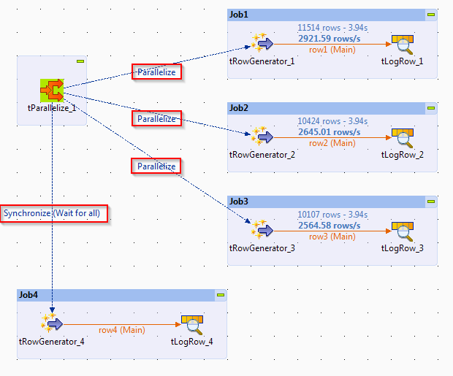
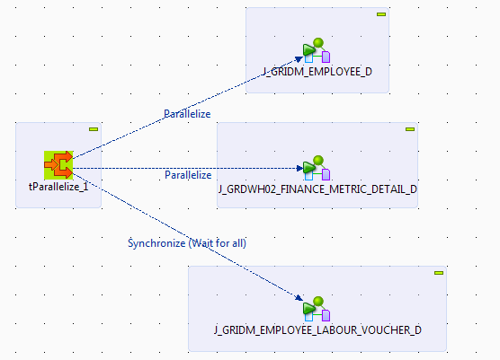
Parent and Child Job (tParallelize & tRun)
TParallelize: The tParallelize component is an Orchestration component. The tParallelize (available in Enterprise Edition) component is used for multiple executions of the jobs at the same time. This can be achieved by multi-threading the jobs.

Slide 67
tParallelize & tRun (Contd..)
tRun: Component allows you to embed one Talend Job within another so that it may be executed as a Talend SubJob.
It executes the Job called in the component's properties, in the frame of the context defined.
tRun helps mastering complex Job systems which need to execute one Job after another. By this means can be utilized to have a parent and child relationship among the Jobs.
tRunJob Component from the Component Palette (Orchestration) of you can drag an existing Job from Job Designs in the Repository Browser.

Slide 68
Talend Big Data DI and Hadoop Components

Slide 69
Talend Big Data DI
BIG DATA- What is it?
Big data refers to the extremely large data sets that may be analyzed computationally to reveal patterns, trends, and associations, especially relating to human behavior and interactions. Eg: NASA Climate Simulation (32 Petabytes)
Specifically, Big Data relates to data creation, storage, retrieval and analysis that is remarkable in terms of volume, velocity and variety.
Big data refers to the extremely large data sets that may be analyzed computationally to reveal patterns, trends, and associations, especially relating to human behavior and interactions.

Slide 70
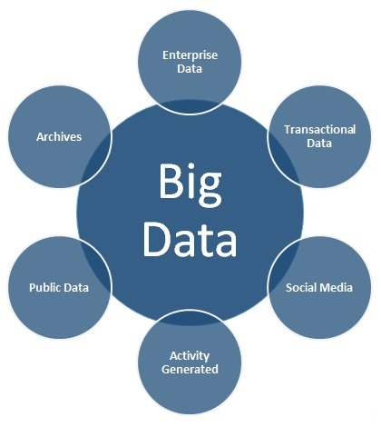
Talend Big Data DI (Contd..)
It includes:
Very large data set volumes
Very Long/ unacceptable processing times
Very large data velocity (inputs / outputs)
Very large varieties of data
High level of complexity

Slide 71
Obstacles: Big Data Integration Challenges
Technology. A successful big data initiative requires acquiring, integrating and managing several big data technologies. It can become an expensive custom-coding nightmare to integrate large sets of diverse structured and unstructured datasets that also becomes difficult to maintain and manage.
Conventional data management tools fail when trying to integrate, search and analyze big datasets, which (for now) range from terabytes to multiple petabytes of information.
People. As with any new technology, staff needs to be trained in big data technologies to learn proper skills and best practices.
A recent Talend survey, “How Big is Big Data Adoption”, found that the two biggest big data implementation challenges are finding in-house expertise, and allocation of sufficient budget, time and resources.
Quality Processes: The survey also found that many big data projects do not have explicit project management structure, data governance, and lack the necessary big data quality procedures when processing unstructured sets of data.

Slide 72
Solution: Talend Big Data
Big Data Integration
Landing big data (large volumes of log files, data from operational systems, social media, sensors, or other sources) into a big data platform such as Apache Hadoop, Google Cloud Platform, Netezza, Teradata or Vertica is a cinch with the breadth of big data components provided by Talend. A full set of Talend data integration components (application, database, service and even a master data hub) is available, so that data movement can be orchestrated from any source or into almost any target. NoSQL connectivity to MongoDB and Cassandra is simplified through pre-built graphical connector components.
Big Data Quality
Talend provides data quality functions that take advantage of the massively parallel environment of Hadoop, allowing you to understand the completeness, accuracy and integrity of data as well as to remove duplicates. Hadoop data profiling allows you do collect information and statistics about big data to assess data quality, repurposing and metadata. Additional functions include standardization, parsing, enrichment, matching, survivorship and monitoring of ongoing data quality.

Slide 73
Solution: Talend Big Data (Contd..)
Big Data Manipulation
Talend supports Apache Pig and HBase so you can perform basic transformations and analysis on massive amounts of data in little time. With these scripting languages you can compare, filter, evaluate and group data within an HDFS cluster. Google Big Query supports allows you to interactively analyze very large datasets. Talend speeds development and collaboration by providing a set of components that allow these scripts to be defined in a graphical environment and as part of a data flow.
Big Data Project Governance and Administration
Governance of a big data project is very similar to any integration project; however, big data projects sometimes lack necessary management functions. Talend presents a simple, intuitive environment to implement and deploy a big data program with the ability to schedule, monitor and deploy any big data job. Also included is a common repository so developers can collaborate and share project metadata and artifacts.

Slide 74
Talend Big Data DI (Contd..)
Big data integration is a key operational challenge for today's enterprise IT departments. IT groups may find their skill sets, workload, and budgets over-stretched by the need to manage terabytes or petabytes of data in a way that delivers genuine value to business users.
Talend, the leading provider of open source data management solutions, helps organizations large and small meet the big data challenge by making big data integration easy, fast, and affordable.

Slide 75
Talend Big Data DI (Contd..)
METADATA
Metadata is definitional data that provides information about or documentation of other data managed in Talend. Repository allows to store metadata about the various data sources that you may connect to.
The Metadata folder in the Repository tree view stores reusable information on files, databases, and/or systems(i.e DB, SAS , FTP etc) that you need to build your Jobs. Use these data sources in Jobs, by dragging an object from the repository to the design area.
Context describes the user-defined parameters that are passed to Job at runtime.
Reusable
Save major re-writes

Slide 76
Talend Big Data DI (Contd..)
Context Variables: are the values that may change as you promote your Job from Development, through to Test and Production
Default Context : As we add Context Variables to the Job, they are added to the Default Context.
Context Groups allows you to easily define a group of Context Variables that can be added to your Job as a group rather that individually adding each Context Variable to every Job that needs it.

Slide 77
Talend Big Data DI (Contd..)
For every Metadata Connection (either file or database), you can export the connect details as a Context.
On the last step or second last step of the wizard, click Export as Context.
The Context creation 2-step wizard launches.
On Step 1, fill out a name for the Context. By default the name of the Metadata entry is proposed.
Click Next.
On Step 2, the automatically created context variables are displaying on the three tab table. Check out that the variable values showing on the Values tab are correctly set.
Click Finish to validate the creation.

Slide 78
Talend Big Data DI (Contd..)
Setting up a DB connection:
STEP 1: General Properties
First expand Metadata in the repository tree view and Right- Click Db Connections and select create connection from the top menu
The connection wizard opens up. Fill in the required information and click Finish.

Slide 79
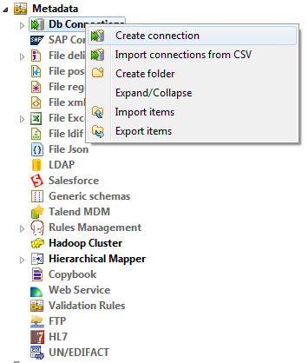
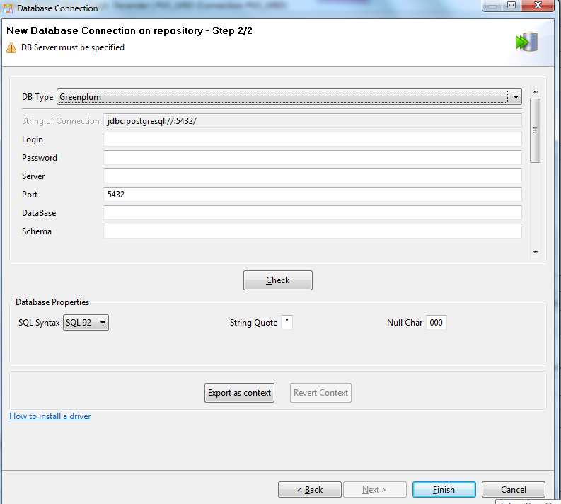
Talend Big Data DI (Contd..)

Slide 80
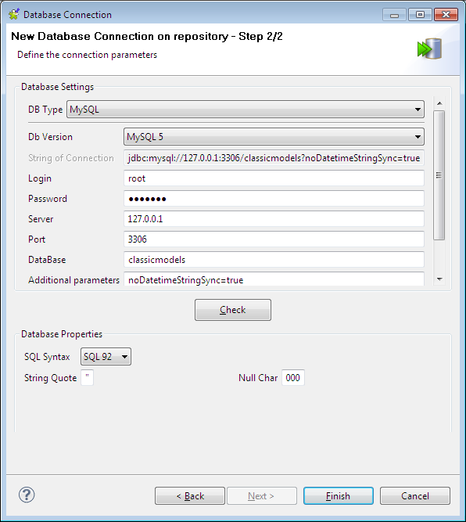
Talend Big Data DI (Contd..)
STEP 2: Connection
Select the type of the database to which you want to connect and some fields will be available/unavailable according to the DB connection detail requirements.
Fill in the connection details and click Check to check your connection.
Fill in, if need be, the database properties information. That is all for the first operation on DB connection setup, click Finish to validate.

Slide 81
Talend Big Data DI (Contd..)
Note: When you are creating the database connection of some databases like AS400, HSQDB, MsSQL, Oracle, Sybase, or Teradata, you can specify additional connection properties through the Additional Parameters field in the Database Setting area.
Note: In order to be able to retrieve all table schemas in the database:
- enter dbo in the Schema field if you are connecting to MSSQL 2000,
- remove dbo from the Schema field if you are connecting to MSSQL 2005/2008.
The newly created DB connection is now available in the Repository tree view and displays four folders including Queries (for SQL queries you save) and Table schemas that will gather all schemas linked to this DB connection.

Slide 82
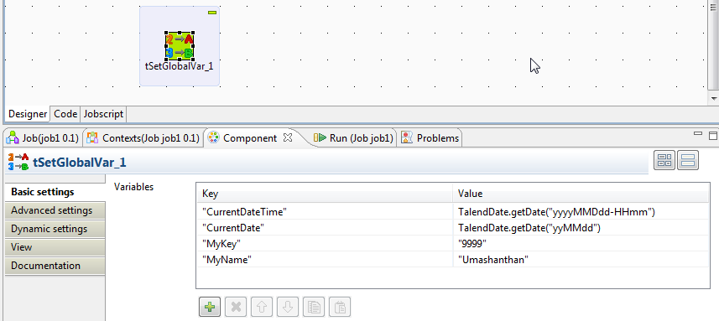
Talend Big Data DI (Contd..)
VARIABLES
Variables represent values which change throughout the execution of a program.
A global variable is a system variable which can be accessed by any module or function. It retains its value after the function or program using it, has completed execution.
A context variable is a variable which is defined by the user for a particular context.

Slide 83
Talend Big Data DI (Contd..)
A context is characterized by parameters. These parameters are context sensitive variables which will be added to the list of variables for reuse in the component specific properties on the component view through the ctrl+space keystrokes.
Talend Studio offers the possibility to create multiple context data sets. Furthermore, you can create context data sets on a one-shot basis from the current tab of a job, or you can centralize the context data sets in the Contexts mode of the Repository tree view in order to reuse them in different jobs.

Slide 84
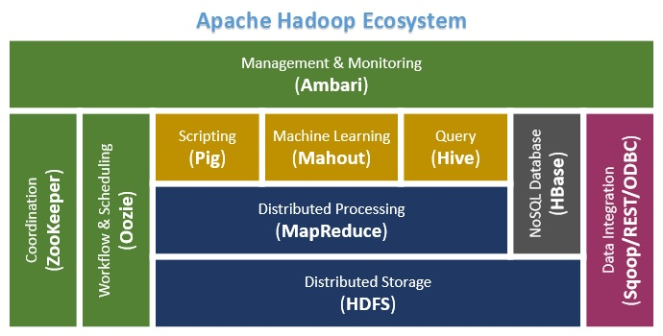
Hadoop Components
CORE HADOOP COMPONENTS:
The Hadoop Ecosystem comprises of 4 core components –
1) Hadoop Common-
Apache Foundation has pre-defined set of utilities and libraries that can be used by other modules within the Hadoop ecosystem. For example, if HBase and Hive want to access HDFS they need to make of Java archives (JAR files) that are stored in Hadoop Common.

Slide 85
Hadoop Components (Contd..)
2) Hadoop Distributed File System (HDFS) -
The default big data storage layer for Apache Hadoop is HDFS
Users can dump huge datasets into HDFS and the data will sit there until the user wants to leverage it for analysis.
HDFS component creates several replicas of the data block to be distributed across different clusters for reliable and quick data access. HDFS comprises of 3 important
components:
NameNode
HDFS operates on a Master-Slave architecture model where the NameNode acts as the master node for keeping a track of the storage cluster and the DataNode acts as a slave node summing up to the various systems within a Hadoop cluster.
DataNode
Secondary NameNode

Slide 86
Hadoop Components (Contd..)
3) MapReduce- Distributed Data Processing Framework of Apache Hadoop
MapReduce breaks down a big data processing job into smaller tasks.
MapReduce is responsible for the analyzing large datasets in parallel before reducing it to find the results.
In the Hadoop ecosystem, Hadoop MapReduce is a framework based on YARN architecture. YARN based Hadoop architecture, supports parallel processing of huge data sets and MapReduce provides the framework for easily writing applications on thousands of nodes, considering fault and failure management.

Slide 87
Hadoop Components (Contd..)
MapReduce framework forms the compute node while the HDFS file system forms the data node. Typically in the Hadoop ecosystem architecture both data node and compute node are considered to be the same. The delegation tasks of the MapReduce component are tackled by two daemons:

Slide 88
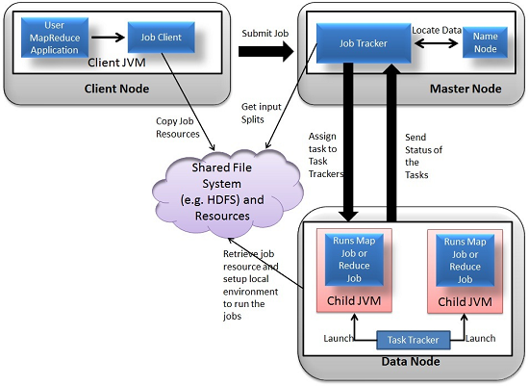
Hadoop Components (Contd..)
Job Tracker and Task Tracker as shown in the image below –

Slide 89
Hadoop Components (Contd..)
4) YARN:
YARN forms an integral part of Hadoop 2.0.YARN is great enabler for dynamic resource utilization on Hadoop framework as users can run various Hadoop applications without having to bother about increasing workloads.
Key Benefits of Hadoop 2.0 YARN Component-
It offers improved cluster utilization
Highly scalable
Beyond Java
Novel programming models and services
Agility

Slide 90
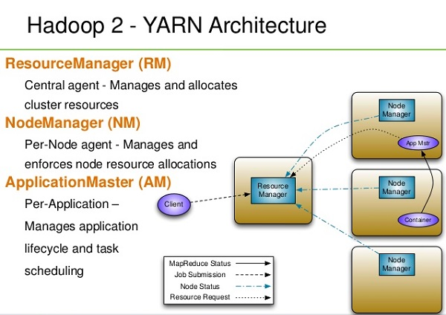
Hadoop Components (Contd..)

Slide 91
Hadoop Components (Contd..)
DATA ACCESS COMPONENTS OF HADOOP ECOSYSTEM- Pig and Hive
PIG
structure is open to considerable parallelization
high level data flow language Pig Latin
data warehouse built on top of Hadoophigh level data
flow language Pig Latin
provides a simple language known as HiveQL
similar to SQL for querying, data summarization and
analysis.
HIVE

Slide 92
Hadoop Components (Contd..)
DATA INTEGRATION COMPONENTS OF HADOOP ECOSYSTEM- Sqoop and Flume
Sqoop
used for importing data from external sources into
related Hadoop components like HDFS, HBase or
Hive
used for collecting data from its origin and sending
it back to the resting location (HDFS).
Flume

Slide 93
Hadoop Components (Contd..)
DATA STORAGE COMPONENT OF HADOOP Ecosystem –HBase
HBase
Is a column-oriented database that uses HDFS for
underlying storage of data.
random reads and also batch computations
using MapReduce.

Slide 94
Hadoop Components (Contd..)
MONITORING, MANAGEMENT AND ORCHESTRATION COMPONENTS OF HADOOP ECOSYSTEM- Oozie and Zookeeper
is a workflow scheduler where the workflows are
expressed as Directed Acyclic Graphs.
makes use of a database to store all the running
workflow instances, their states ad variables along with
the workflow definitions to manage Hadoop jobs
Oozie
Zookeeper
provides simple, fast, reliable and ordered
operational services for a Hadoop cluster.

Slide 95
Hadoop Components (Contd..)
AMBARI
provides easy to use web user interface for Hadoop management.
provides step-by-step wizard for installing Hadoop ecosystem services.
facilitates the metrics collection, alert framework, which can monitor the health status of the Hadoop cluster.
MAHAUT
provides implementation of various machine learning algorithms.
helps with considering user behavior in providing suggestions, categorizing and classifying the items, supporting in implementation group mining or item set mining.

Slide 96
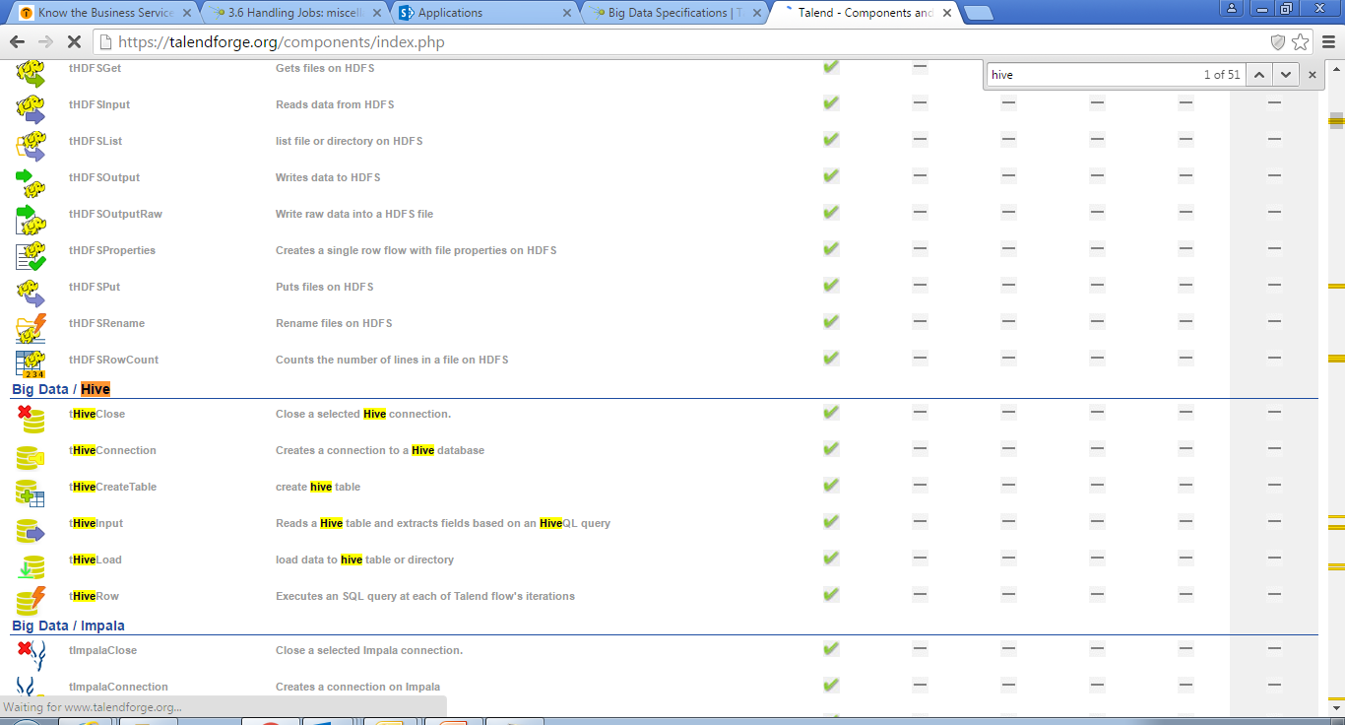

Hadoop Components (Contd..)

Slide 97


Slide 98
Configuring and Running the jobs on remote server from Studio

Slide 99

Configuring and running the jobs on remote server from Studio
Distant run configuration (Talend > Run/Debug)
In Talend Studio, we can transfer, via a Command line, your Jobs on a distant server, which will be in charge of deploying and executing them. To remotely execute our Jobs, we need to configure the remote server details in the Studio preferences. To configure the Command line we will use:
From the menu bar, click Window > Preferences to open the [Preferences] dialog box.
Expand the Talend and the
Run/Debug nodes in succession
and then click Remote.

Slide 100
Configuring and running the jobs on remote server from Studio (Contd..)
To add a remote Job server:
In the Remote Jobs Servers area, click the [+] button to add a new line in the table.
Fill in all fields as configured for the Job execution server in Talend Administration Center: Name, Host name (or IP address), Standard port, Username, Password, and File transfer Port.
The Username and Password fields are not required if you have not configured users into the configuration file of the Job Server.

Slide 101
Configuring and running the jobs on remote server from Studio (Contd..)
To add a remote commandline:
Select the Enable commandline server check box if you want to use a remote commandline.
Click the plus button to add a new line in the table.
Fill in the fields as configured for the commandline in Talend Administration Center: Name, Host name (or IP address), and Port.
Click Apply and OK to validate the changes.

Slide 102
Run a Job Remotely
To run a Job on a remote server and via a remote commandline, make sure that:
you have set the remote processing server and commandline details under Talend Studio Preferences
The agent is running on the remote server.
Once these operations are complete, perform the following:
Go to the Run view of Talend Studio design workspace.
Click the Target Exec tab in the Run view.
Select the relevant remote server on the list.
The Commandline Server list appears.
In this list, select the relevant remote commandline server.

Slide 103

Run a Job Remotely (Contd..)
Click the Run button of the Basic Run tab, as usual, to connect to the server and deploy then execute in one go the current Job.

Slide 104
Talend Administration center

Slide 105
Talend Administration Center
A web-based application centralizing the management and administration of your studio
Talend Administration Center also centralizes the users' role management and access rights to your projects and the scheduling and monitoring of processes(Jobs)
Projects and processes are all centralized in a remote repository enabling resource sharing and project configuration.
However this advanced configuration mode cannot be done through the Web interface of Talend Administration Center.

Slide 106
Talend Administration Center (Contd..)
Talend Administration Center allows you to:
Manage operating and connection information via the Configuration page of the application.
Administrate projects, manage users and licenses via the Projects, Users and Licenses pages.
Schedule deployment and roll-out of processes (Jobs) via the Conductor node and monitor them via the Monitoring node.

Slide 107
Talend Administration Center (Contd..)
Managing Users : From the Users page, you can manage the users of Talend Studio stored in the remote repository.
To access the list of user accounts, click Users in the Menu tree view. This list displays all accounts whether they are Administrators, Operation managers, Designers or Viewers.
Note that when you access this list for the first time, only the default administrator account shows on the list.
The buttons on the toolbar of the Users page allow you to refresh the display of the account list, add a new account, duplicate an account which already exists, delete one or more accounts and import users.
The right panel of the Users page allows you to create new user accounts and to modify selected accounts. The two areas, Data and Connection stats, in this panel display more detailed information about the selected account

Slide 108

Talend Administration Center (Contd..)

Slide 109

Talend Administration Center (Contd..)
Managing project authorizations: allows you to manage user authorizations
give a user the right to access one or more projects
specify if the access right is read-only or read-write
To display the project authorization list for the users of Talend Studio:
In the Menu tree-view, click Project Authorizations.
The list of projects is displayed in the Project panel and the list of users is displayed in the User/Project Authorizations for the Project: <project Name> panel if you ordered authorizations by projects.

Slide 110
Talend Administration Center (Contd..)
Authorizing users
If authorizations are ordered by projects
In the Menu tree-view, select Project authorizations to display the authorization list.
In the Project panel, select the project to which you want to assign a user.
In the Right column of the User panel, give read or read and write permissions to a user by clicking the corresponding icons.
If authorizations are ordered by users
In the Menu tree-view, select Project authorizations to display the authorization list.
In the User panel, select the user you want to assign to a project.
In the Right column of the Project panel, give read or read and write permissions to the user by clicking the corresponding icons.

Slide 111
Talend Administration Center (Contd..)
Scheduling execution tasks:
On the Job Conductor page, you can schedule an execution task using different types of triggers.
Time-based triggers (Simple Trigger):
Periodic multi-platform CRON-like triggers (CronUI Trigger):
File-based triggers (FileTrigger):

Slide 112

Talend Administration Center (Contd..)
How to add a simple trigger onto a task
On the Job Conductor page, select the task
you want to implement a trigger on
In the bottom half of the page and in the
Triggers view, click Add trigger...
and then select Add simple trigger from the
drop-down list. The Simple trigger configuration
panel opens.

Slide 113
Talend Administration Center (Contd..)
Enter the following information:
Field | Description
Number of repetitions | Type in the number of execution that should occur in addition to the first execution. If you do not fill this field: as many executions as possible within the time frame given 0: only the first execution is carried out. n: n extra execution is carried out in addition to the first one.
Time interval | Type in (in sec) the time interval between triggerings. For long interval, use CRON-based triggers.
Pause trigger on error | Select the check box in order to pause the trigger if an error occurs during the execution of the task.
Description | Provide a description if the type of trigger is not obvious enough
Time zone | In the dialog box, select the time zone of the triggering time in the list. It can be the execution server time, the Web application time or another time zone you define. To take advantage of the autocomplete feature, type the first three letters of the time zone you are searching for.
Label | Give a name to the trigger you are setting
Start time | Click the calendar button to open a calender. Click the date and set the exact time for the trigger to be executed. The time format must be HH:MM:SS If you do not fill this field, the triggering is immediate IconNote For immediate triggering, we advise you to click the execute button on the table.
End time | Click the calendar button to open a calendar. Click the date and set the exact time for the trigger to be executed. The time format must be HH:MM:SS. If you do not fill this field: the Job will be executed indefinitely (until the number of repetitions is reached, if any

Slide 114
Talend Administration Center (Contd..)
Click Save to validate the simple trigger configuration or Cancel to cancel the operation.
The Trigger Status icon for the selected task changes from No Trigger to At least one trigger is running.
Note that, if the task is already running when the task is triggered, the Job Conductor will wait for the current task to finish. If the task is not finished after 60 seconds, then the status of the task execution changes to 'misfired'. A misfired event also occurs if the trigger misses its firing time because of Talend Administration Center is shutdown.

Slide 115
Contact information
Insert contact picture
Name Last Name
Title/Role name.lastname@capgemini.com
Capgemini Office (Optional) Address Line 1
Address Line 2
Address Line 3
Insert contact picture
Name Last Name
Title/Role name.lastname@capgemini.com
Capgemini Office (Optional) Address Line 1
Address Line 2
Address Line 3
Insert contact picture
Name Last Name
Title/Role name.lastname@capgemini.com
Capgemini Office (Optional) Address Line 1
Address Line 2
Address Line 3
Insert contact picture
Name Last Name
Title/Role name.lastname@capgemini.com
Capgemini Office (Optional) Address Line 1
Address Line 2
Address Line 3

